Slide 1

Predicting US Public Transit Ridership
Daniel Pickett
March 2023

Slide 2
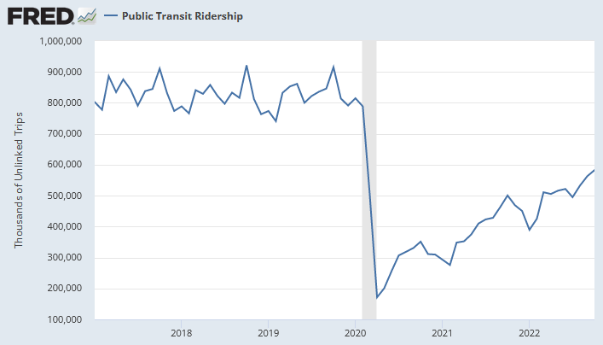
Problem context
US public transit lines are generally underused and underfunded
COVID pandemic has only worsened their utilization
Some recent statistics¹:
US ridership, Jan 2017: ~802,693k (~2.47 per capita)
US ridership, Apr 2020: ~171,450k (~0.52 per capita)
US ridership, Jan 2022: ~389,396k (~1.17 per capita)
¹ Source: https://fred.stlouisfed.org

Slide 3
Problem statement
Given monthly data on the ridership of each regional transit line across the US between the years 2002 and 2022, can we use time series forecasting to predict the ridership of each line for the year 2023 (and on)? Are any of these lines likely to reach pre-COVID ridership levels within the near future?

Slide 4
About the data
2,237 records, where each record represents a US regional transit line
12 fields of descriptive characteristics, each line a unique combination of:
Agency: the name of the overarching transit property that owns the line
Mode: the type of transit the line provides – bus, light rail, direct response, etc.
Type of service (TOS): whether the line is owned by the agency, or operated by a third party through a purchased agreement
14 fields of summary statistics – recent total ridership, recent total fares, etc.
250 fields of ridership numbers, our time series data
Each field represents a month between Jan 2002 and Oct 2022 (the most recent month of data when this project was started)
Ridership defined officially as unlinked passenger trips (UPT): the number of passengers who board the transit vehicle, regardless of how many total vehicles they use to reach their destination
We care mostly about recent history – between Jan 2017 and Oct 2022

Slide 5
Data wrangling
Objectives:
Check data for incorrect or missing values
Add or adjust these values where possible, or exclude their records from forecasting
Bring the number of lines we analyze to a reasonable number

Slide 6
Data wrangling (cont.)
683 records labeled as “inactive” – these lines are out of service
Removed from the data
Check for mistyped values: N/A
Check for duplicate records: N/A
Check for missing data:
421 records missing numerous descriptive/summary values
Removed from the data
169 records missing more than 10% of their recent ridership history
Removed from the data
Check for faulty fields: N/A
Check for other suspicious values or trends: N/A
Final data after wrangling: 964 records, all original 276 fields

Slide 7
Exploratory data analysis
Objectives:
Determine records to exclude from forecasting based on the properties of their data
Identify trends by group both pre-COVID and post-COVID
Continue bringing the number of lines we analyze to a reasonable number

Slide 8
Exploratory data analysis (cont.)
For each agency, calculated the percentage of total UPT in the last fiscal year that each mode made up
422 records made up less than 10% of their agency’s UPT
Removed from the data
Determined modes that didn’t fit the purposes of this analysis
Modes that are the only way to reach a destination (e.g. inclined plane)
Modes that are primarily tourist attractions (e.g. cable car)
Modes that technically transport multiple people but don’t provide the expected services of typical mass transit (e.g. vanpools)
43 total records removed from the data

Slide 9
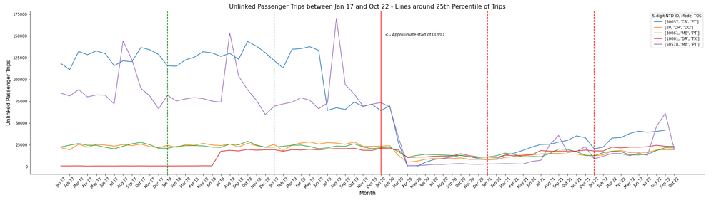
Exploratory data analysis (cont.)
Attempted to visualize patterns among records with similar traits, around similar quartiles
1st attempt: Records with similar flat UPT numbers from the last fiscal year
Didn’t account for what they were like pre-COVID, since FY numbers were all post-COVID
2nd attempt: Records with similar service area populations
Didn’t account for annual seasonality among different types of lines

Slide 10
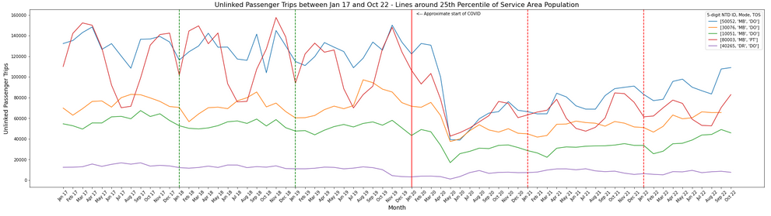
Exploratory data analysis (cont.)
2nd attempt: Records with similar service area populations
Didn’t account for annual seasonality among different modes of lines

Slide 11
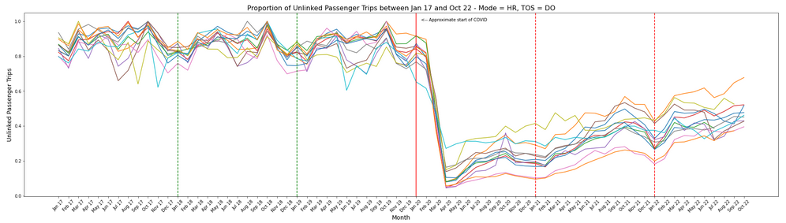
Exploratory data analysis (cont.)
3rd attempt: Records with the same mode and TOS, with UPT standardized by its recent pre-COVID maximum (between Jan 2017 and Dec 2019)
Similar patterns emerge among lines of similar modes, despite different area populations

Slide 12
Exploratory data analysis (cont.)
Emergent patterns:
UPTs of similar lines expressed similar annual seasonality, even if magnitude differs
For nearly every line, the maximum UPT was achieved pre-COVID, with neighboring UPTs generally at similar levels
As COVID began - between Jan 2020 and Apr 2020 - each line’s UPT fell to between 0% and 40% of its pre-COVID maximum
Over the next 3 years, UPTs climbed slowly toward pre-COVID levels, but mostly reached between 25% and 75% of their original maximum
Post-COVID UPTs don’t necessarily express similar annual seasonality to their pre-COVID levels
Determined which lines were most likely to reach their pre-COVID levels
Threshold: At least 12 post-COVID months with at least 75% of pre-COVID maximum UPT
475 lines did not meet this threshold – removed from the data
Final data after EDA: 24 records, all original 276 fields
Breakdown by mode: 13 direct response, 9 local bus, 2 commuter bus

Slide 13
Pre-processing the data
Objective: Arrange the data so that it is ready for modeling
No fields are categorical – no transformation into dummy or indicator variables required
UPT data standardized by its recent pre-COVID maximum
UPT data split into training and testing sets
Training data: Jan 2017 to Dec 2021
Testing data: Jan 2022 to Oct 2022
Final data after pre-processing:
X and y training sets: 60 historical UPT values
X and y testing sets: 10 historical UPT values
All sets retain the 24 records, 12 descriptive characteristics, and 14 summary statistics

Slide 14
Modeling
Objectives:
Determine if stationarity exists among the lines’ UPT data
Make any necessary transformations so that the UPT data becomes stationary
Determine the optimal time series model for each line
Forecast each line’s UPT using its optimal model

Slide 15
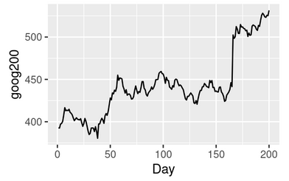
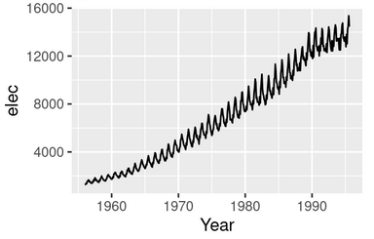
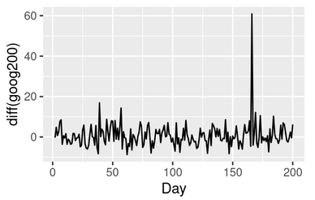
Determining stationarity
Stationarity: The statistical properties of a time series dataset do not change over time
Constant mean
Zero variance
Zero correlation between data at each distance in time (autocorrelation)
Stationarity allows us to model on a single set of assumptions about the data, instead of ones that constantly change
Signs of non-stationarity:
Trend: Data generally increases/decreases throughout the entire time period
Seasonality: Data cyclically increases/decreases throughout a repeating unit of time
Source of graphs: https://otexts.com/fpp2/stationarity.html

Slide 16
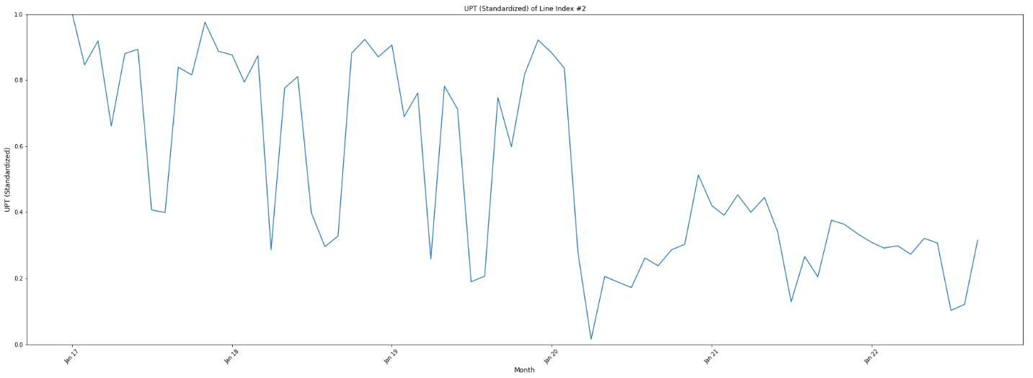
Determining stationarity (cont.)
Example of non-stationary data:
Downward trend
Seasonal patterns in data

Slide 17
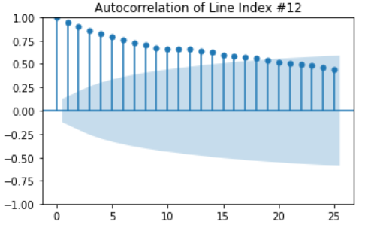
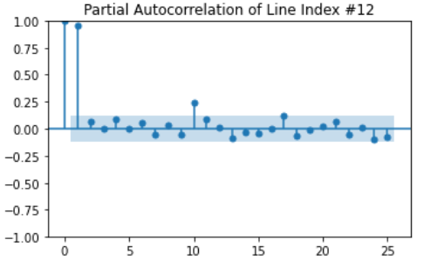
Determining stationarity – (partial) autocorrelation
Graph autocorrelation and partial autocorrelation functions
Autocorrelation function (ACF): Shows how much the current value of a variable is affected by past values, including their effect on values in between
Partial autocorrelation function (PACF): Shows how much the current value of a variable is affected by past values, not including their effect on values in between
Positive (P)ACF values indicate trend-following; negative (P)ACF values indicate mean-reverting
The closer the absolute (P)ACF value is to 1, the stronger its effect on the current value of the variable
Past values whose (P)ACF values are outside the confidence range (in blue) have a significant effect on the current value
Every line showed:
Many consecutive significant positive ACF values
Varying scattered significant PACF values, both positive and negative

Slide 18
Transforming the data
Transformations: Mathematical shifts made in the data so that it becomes stationary
The original data is still represented, just in a different way
Common transformations:
Differencing by a single unit of time – good for adjusting linear trend
Differencing by more than one unit of time – good for adjusting seasonality
Taking the log – good for adjusting exponential trend
To determine which transformations to apply, run an Augmented Dickey-Fuller (ADF) test on each line’s UPT data
Test results showed that:
13 lines required taking the log of their data
All 24 lines required differencing by both month and year

Slide 19
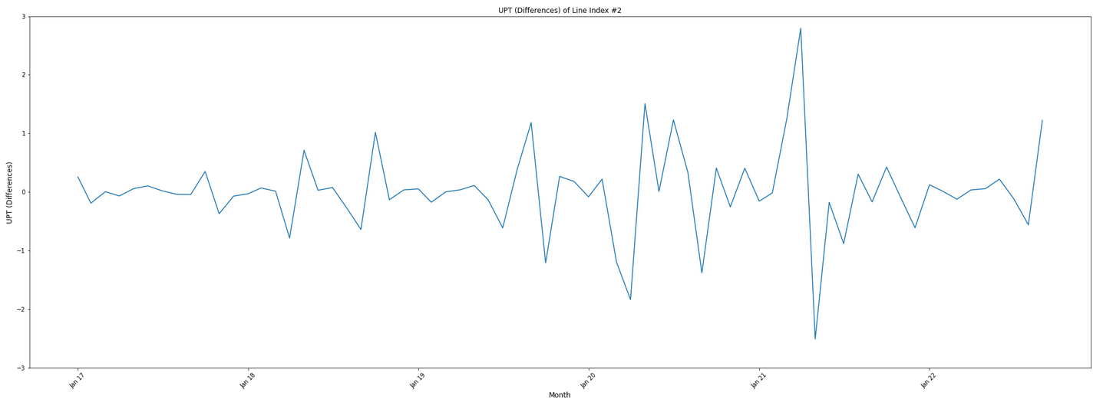
Transforming the data – post-transformation
Resulting stationary data:
Constant (no) trend
No more seasonal patterns in data

Slide 20
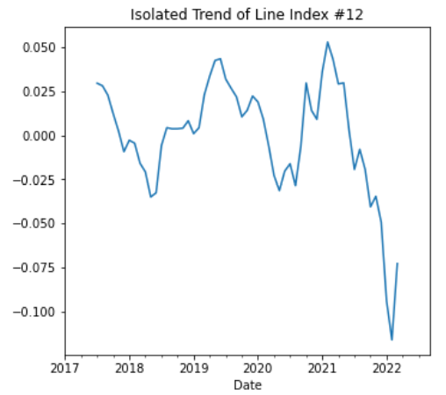
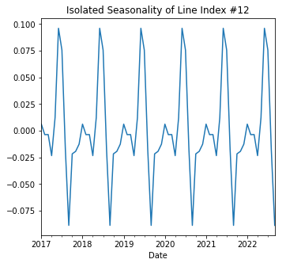
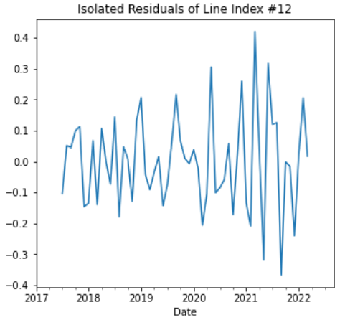
Transforming the data – seasonal decomposition
Seasonal decomposition: Isolating the individual components of a time series – trend, seasonality, and residuals – to examine them in depth
For a stationary model, all three components should average 0 without pattern
After transformation, decomposition visually confirms that all lines exhibit stationarity

Slide 21

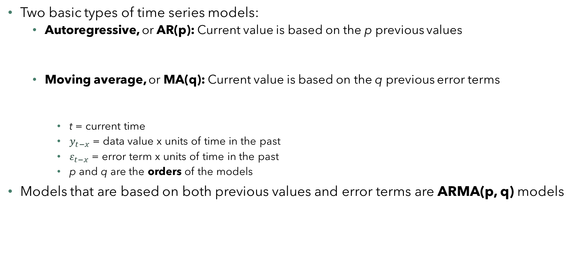

Determining the models
Two basic types of time series models:
Autoregressive, or AR(p): Current value is based on the p previous values
Moving average, or MA(q): Current value is based on the q previous error terms
t = current time
$y_{t−x}$ = data value x units of time in the past
$ε_{t−x}$ = error term x units of time in the past
p and q are the orders of the models
Models that are based on both previous values and error terms are ARMA(p, q) models
$$y_{t}=a_{1}y_{t−1}+…+a_{p}y_{t−p}+ε_{t}$$
$$y_{t}=m_{1}ε_{t−1}+…+m_{q}ε_{t−q}+ε_{t}$$
$$y_{t}=a_{1}y_{t−1}+…+a_{p}y_{t−p}+m_{1}ε_{t−1}+…+m_{q}ε_{t−q}+ε_{t}$$

Slide 22
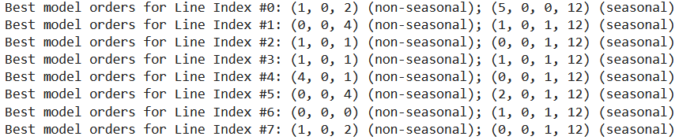
Determining the models – SARIMA
SARIMA(p, d, q)(P, D, Q, s): An extension of ARMA models that also accounts for seasonality (S) and differencing (I)
s = # units of time that make up a season
[d] = # units of time that the data should be differenced by
SARIMA models are therefore also based on the previous P seasons of values and Q seasons of error terms
$$y_{t}=a_{1}y_{t−1}^{[d−1]}+…+a_{p}y_{t−p}^{[d−1]}+m_{1}ε_{t−1}^{[d−1]}+…+m_{q}ε_{t−q}^{[d−1]}+ε_{t}$$
$$+n_{1}y_{t−1}^{[D−1]}+…+n_{sP}y_{t−sP}^{[D−1]}+r_{1}ε_{t−1}^{[D−1]}+…+r_{sQ}ε_{t−sQ}^{[D−1]}$$
Models automatically determined via pmdarima.auto_arima

Slide 23
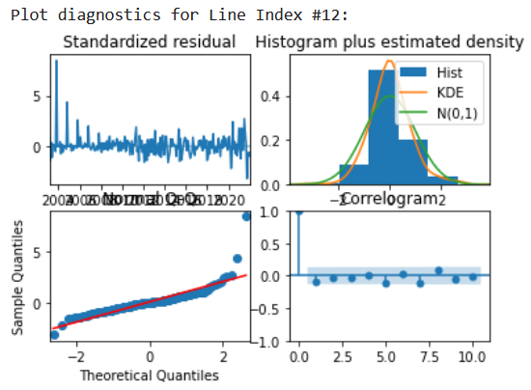
Determining the models – plot diagnostics
Quick checks to confirm model is behaving properly:
Standardized residuals: Plot of values of residuals in the model
Should center around 0 and have no distinct pattern
All models’ residuals have no distinct pattern
Histogram: Distribution of residuals in the model
Should be normally distributed (in green)
Models’ residuals (in yellow) are generally symmetric around 0 but also more distributed around 0
Normal Q-Q: Another way to visualize the distribution of residuals
Should mostly lie along the red line, except for some values at the end
Models’ residuals curve slightly up then down along the red line
Correlogram: ACF plot of residuals
All lags should be insignificant
Nearly all models’ lags are insignificant

Slide 24
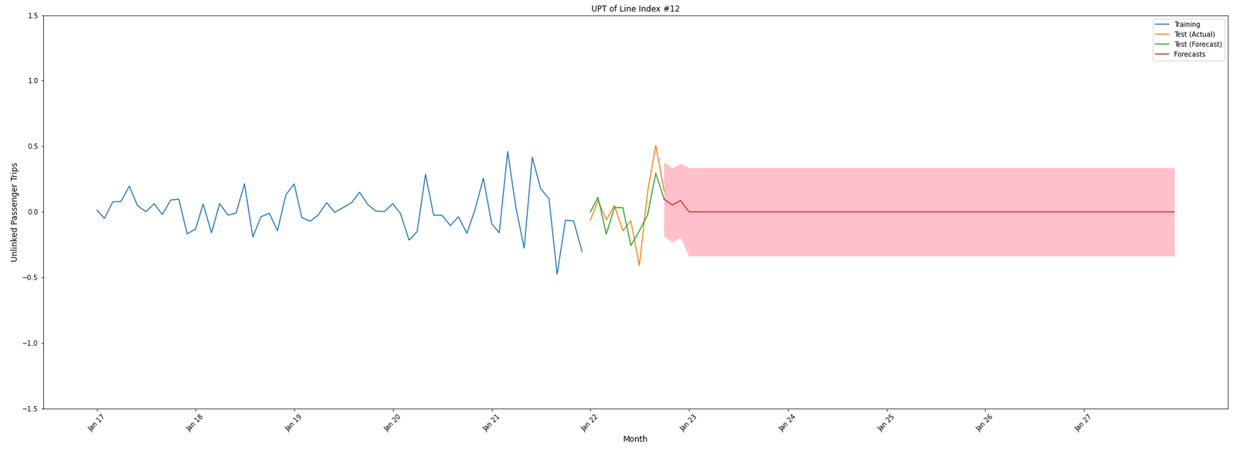
Forecast UPT – transformed data
Resulting forecast:

Slide 25
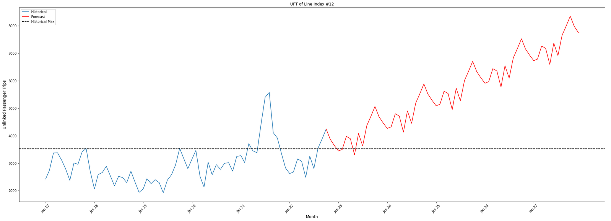
Forecast UPT – original data
Resulting forecast:

Slide 26
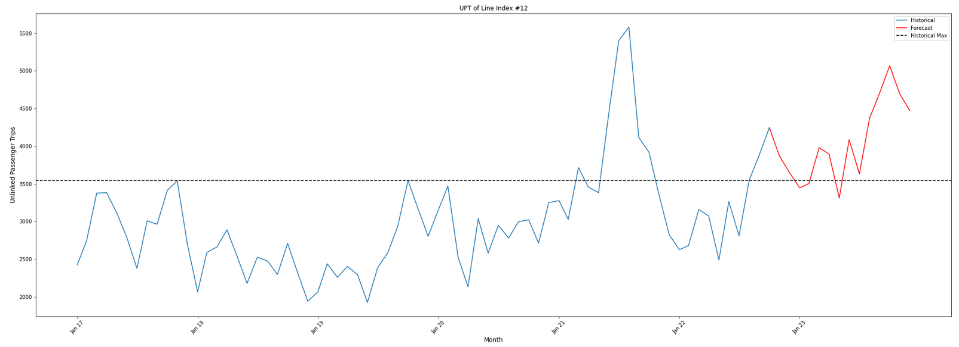
Forecast UPT – takeaways
Predictions largely mimic the seasonality of the last year of historical UPT data
Possibly because most recent data was post-COVID, often far different from pre-COVID data
Many lines’ predicted trend beyond the first year unreasonably mimics that of the first year
First year of predictions likely the most accurate
If so:
12 lines achieve their maximum pre-COVID UPT by 2023, and are projected to keep increasing
3 lines achieve their maximum pre-COVID UPT by 2023, but are projected to become unable to maintain it
2 lines do not achieve their maximum pre-COVID UPT by 2023, but may achieve it in 2-3 years
No immediately discernable correlation with a line’s success and its mode, TOS, service area population, or any other provided summary/descriptive value

Slide 27
Notes for future research
Consider incorporating exogenous variables (population growth, etc.) so that later predictions make more sense
Dig deeper into summary/descriptive values to see if there is correlation with predicted UPT
Focus analysis more on a subcategory of the lines (by mode, population range, etc.)
We had a high percentage of success among lines already determined to be likely to succeed – consider analyzing more lines in the original data for a more accurate overall picture

